Slide 1
40 KPIS TELECOMS MUST TRACK

Slide 2
Thank You For Downloading These Templates
Along with these 40 essential metrics, we’ve also included a handy list of definitions and an explanation of how to calculate the main key performance indicators (KPIs).
We hope you find these helpful.

Slide 3
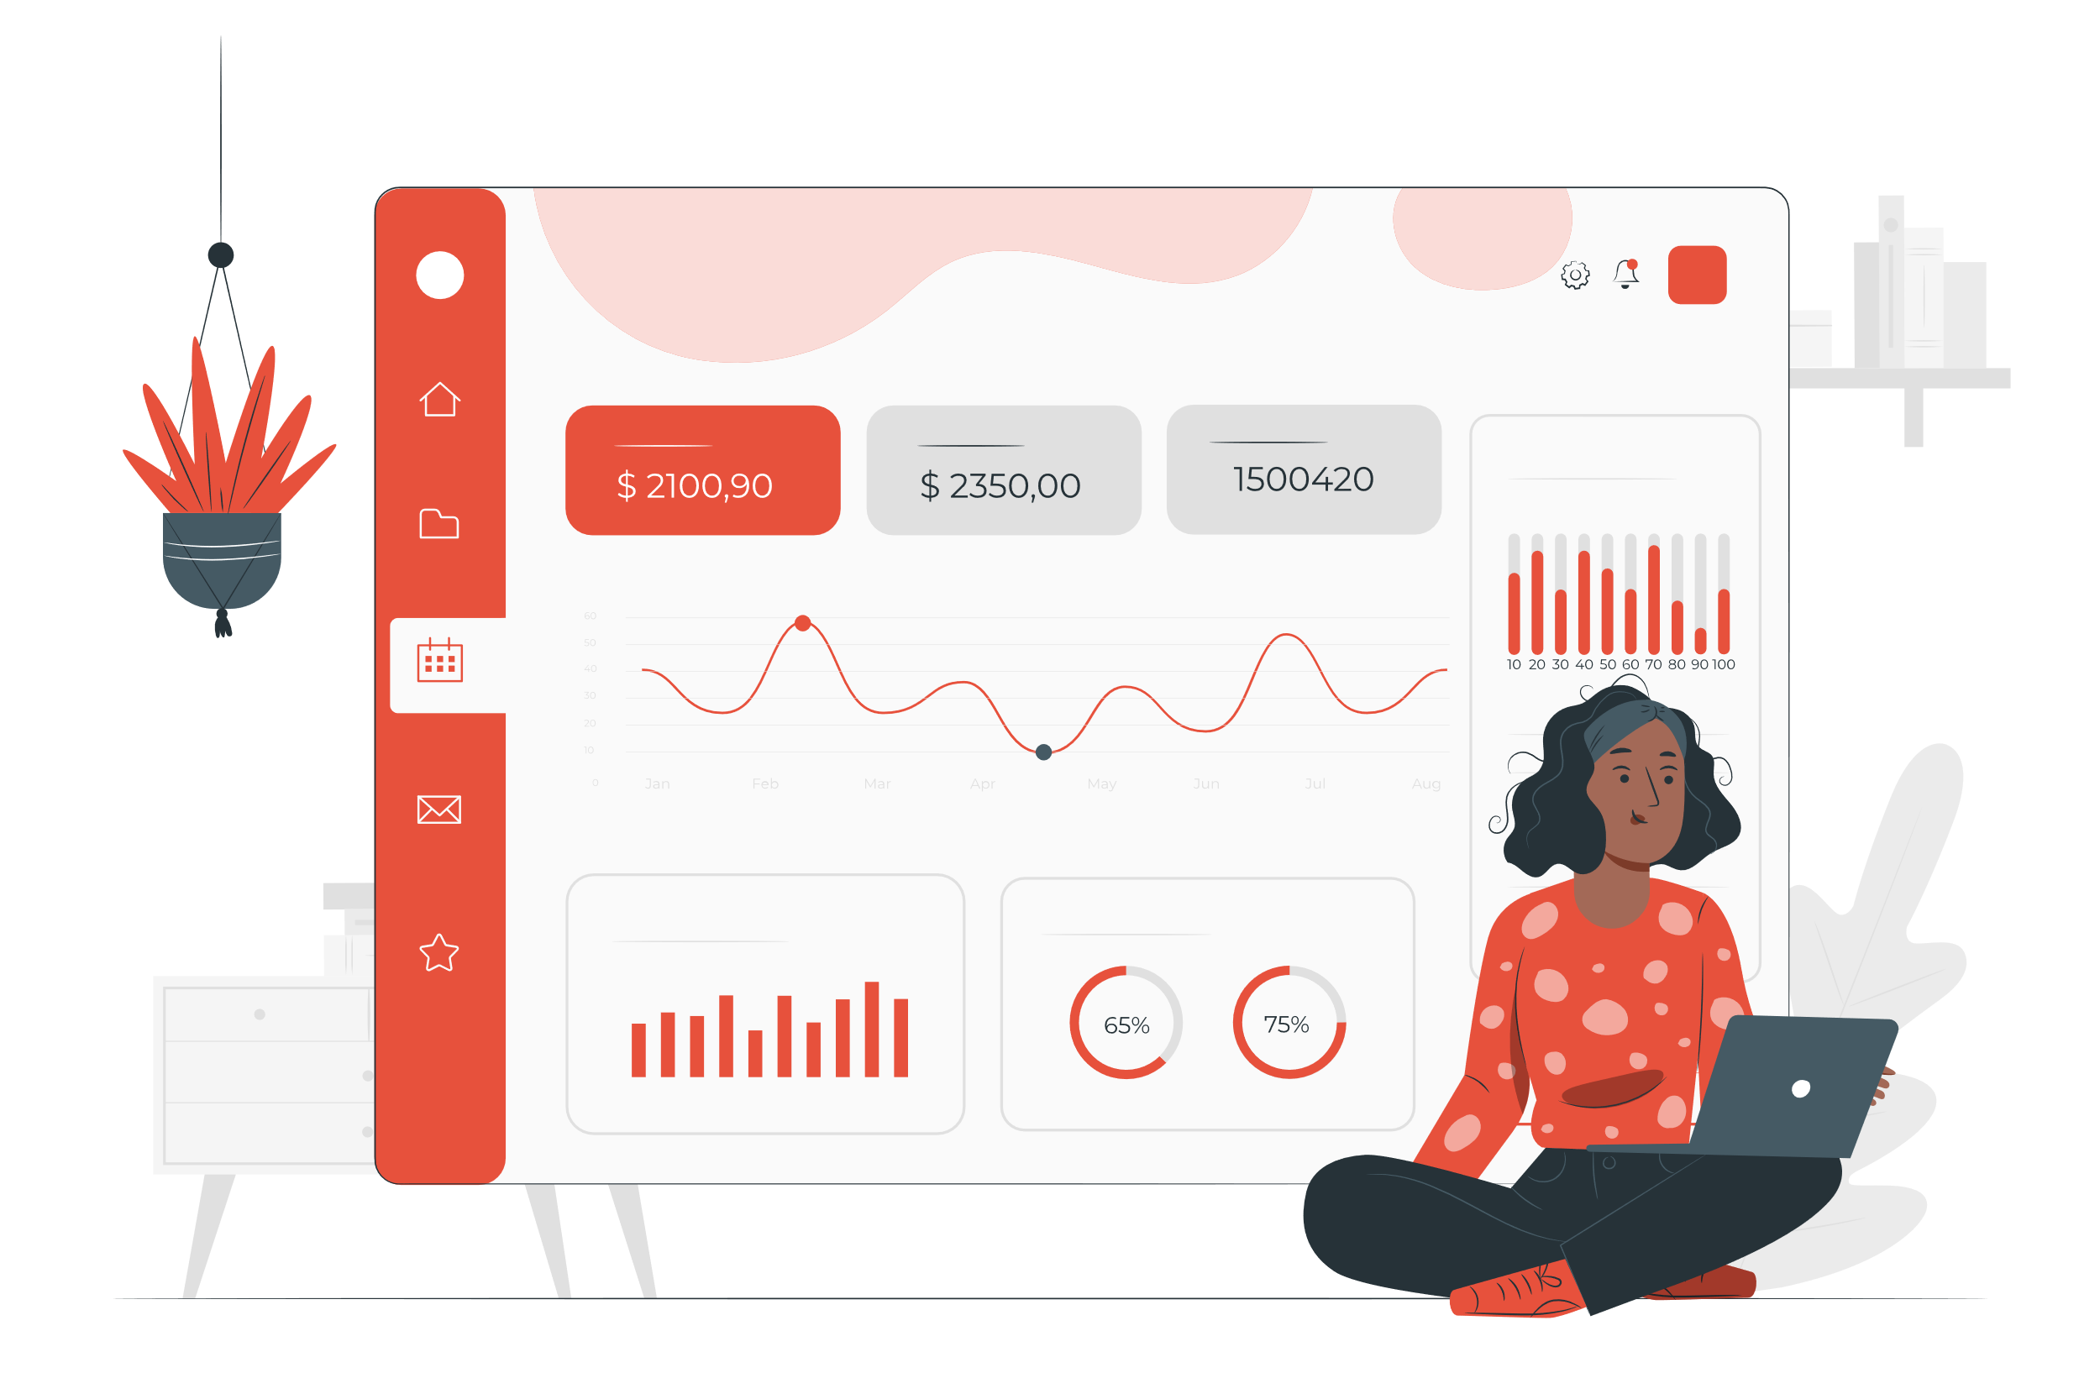
Why Track These KPIs?
The MVNO space is becomingly increasingly diverse and competitive. It's growing five times faster than the telecom operator market, but churn is high.
Thus, customer satisfaction is top priority. Yet, customers' purchase decision windows close quickly; this makes it critical to identify dynamic microsegments of customers.
Real-time analytics can predict customer behavior, and AI can power up marketing campaign management – but only if you're tracking the right information about your subscribers.
These KPIs will give you that valuable insight.

Slide 4
What KPIs Will We Track?
We recommend tracking key performance indicators in for the following areas.
KPI
What it measures
ASPU Impact
All revenue from voice and data.
Data ASPU Impact
Revenue from data only.
Voice ASPU Impact
Revenue from voice only.
MOU Impact
How many minutes subscribers use their mobile devices.
MB Impact
Data usage, in megabytes, per subscriber.

Slide 5
Definitions
Terms you’ll see in these KPIs
Abbreviation | Term | Definition
TG | Target Group | Subscribers included in the target group.
CG | Control Group | Subscribers not included in the target group.
RGU | Revenue Generating Unit | A service subscriber that creates recurring revenue. One customer can be subscribed to multiple services, in which case they will be counted as one customer but multiple RGUs.
ARPU | Average Revenue Per User | Calculated by dividing the total revenue by the average number of users.

Slide 6
Definitions
Terms you’ll see in these KPIs
Abbreviation | Term | Definition
ASPU | Average Spending Per User | Average spending per user per month. Calculated by dividing monthly service revenue by the average number of unique customers.
MOU | Minutes of Usage | Average time, in minutes, a user uses their mobile phone/device.
MB | Megabyte | A data measurement unit equal to 1,048,576 bytes or approximately 1/1000 of a gigabyte.

Slide 7
ASPU Impact
Measures Overall Revenue

Slide 8
ASPU Impact KPIs
KPI | What it measures
TG Pre ASPU | Target group's revenue per subscriber before the measurement period.
TG Post ASPU | Target group's revenue per subscriber after the measurement period.
TG ASPU Uplift | Lift in revenue per subscriber for the target group. Calculated by subtracting the Pre ASPU from the Post ASPU.
CG Pre ASPU | Control group's revenue per subscriber before the measurement period.
CG Post ASPU | Control group's revenue per subscriber after the measurement period.
CG ASPU Uplift | Lift in revenue per subscriber for the control group. Calculated by subtracting the Pre ASPU from the Post ASPU.
Net ASPU Impact | Net revenue impact per subscriber. Calculated by finding the difference between the target group and the control group.
Incremental Revenue | Total incremental revenue for this cohort.

Slide 9
ASPU Impact KPIs

Slide 10
Data ASPU Impact
Measures Only Revenue From Data

Slide 11
Data ASPU KPIs
KPI | What it measures
TG Pre Data ASPU | Target group's data-only revenue per subscriber before the measurement period.
TG Post Data ASPU | Target group's data-only revenue per subscriber after the measurement period.
TG Data ARPU Uplift | Lift in data-only revenue per subscriber for the target group. Calculated by subtracting the Pre ARPU from the Post ARPU.
CG Pre Data ASPU | Control group's data-only revenue per subscriber before the measurement period.
CG Post Data ASPU | Control group's data-only revenue per subscriber after the measurement period.
CG Data ARPU Uplift | Lift in data-only revenue per subscriber for the control group. Calculated by subtracting the Pre ARPU from the Post ARPU.
Net Data ARPU Impact | Net data-only revenue impact per subscriber. Calculated by finding the difference between the target group and the control group.
Incremental Data Revenue | Total incremental data-only revenue for this cohort.

Slide 12
Data ASPU KPIs

Slide 13
Voice ASPU Impact
Measures Only Revenue From Voice

Slide 14
Voice ASPU KPIs
KPI | What it measures
TG Pre Voice ASPU | Target group's voice-only revenue per subscriber before the measurement period.
TG Post Voice ASPU | Target group's voice-only revenue per subscriber after the measurement period.
TG Voice ARPU Uplift | Lift in voice-only revenue per subscriber for the target group. Calculated by subtracting the Pre ARPU from the Post ARPU.
CG Pre Voice ASPU | Control group's voice-only revenue per subscriber before the measurement period.
CG Post Voice ASPU | Control group's voice-only revenue per subscriber after the measurement period.
CG Voice ARPU Uplift | Lift in voice-only revenue per subscriber for the control group. Calculated by subtracting the Pre ARPU from the Post ARPU.
Net Voice ARPU Impact | Net voice-only revenue impact per subscriber. Calculated by finding the difference between the target group and the control group.
Incremental Voice Revenue | Total incremental voice-only revenue for this cohort.

Slide 15
Voice ASPU KPIs

Slide 16
MOU Impact
Measures
Minutes of Usage

Slide 17
MOU Impact KPIs
KPI | What it measures
TG Pre MOU per Sub | Target group's minutes of usage per subscriber before the measurement period.
TG Post MOU per Sub | Target group's minutes of usage per subscriber after the measurement period.
TG MOU Uplift | Lift in minutes of usage per subscriber for the target group. Calculated by subtracting the Pre MOU from the Post MOU.
CG Pre MOU per Sub | Control group's minutes of usage per subscriber before the measurement period.
CG Post MOU per Sub | Control group's minutes of usage per subscriber after the measurement period.
CG MOU Uplift | Lift in minutes of usage per subscriber for the control group. Calculated by subtracting the Pre MOU from the Post MOU.
Net MOU Impact | Net minutes of usage impact per subscriber. Calculated by finding the difference between the target group and the control group.

Slide 18
MOU Impact KPIs

Slide 19
MB Impact
Measures Data Usage (In Megabytes) per subscriber

Slide 20
MB Impact KPIs
KPI | What it measures
TG Pre MB per Sub | Target group's data usage in megabytes per subscriber before the measurement period.
TG Post MB per Sub | Target group's data usage in megabytes per subscriber after the measurement period.
TG MB Uplift | Lift in data usage per subscriber for the target group. Calculated by subtracting the Pre MB from the Post MB.
CG Pre MB per Sub | Control group's data usage in megabytes per subscriber before the measurement period.
CG Post MB per Sub | Control group's data usage in megabytes per subscriber after the measurement period.
CG MB Uplift | Lift in data usage per subscriber for the control group. Calculated by subtracting the Pre MB from the Post MB.
Net MB Impact | Net data usage impact per subscriber. Calculated by finding the difference between the target group and the control group.

Slide 21
MB Impact KPIs

Slide 22
Absolutdata is Your AI & Analytics Partner
And NAVIK AI is telecom's go-to marketing intelligence solution

Slide 23
EXPERIENCED
TRUSTED
We’ve worked with telecommunications companies for decades, and we know how to turn your data into optimal marketing campaign recommendations.
We can help you automate all aspects of marketing campaign management for increased customer retention and ROI.
If you need help coming up with attractive offers or optimizing your spending, we have the expertise and the platform to do it.
Absolutdata has been recognized in 5 different Gartner Hype Cycle reports as a featured vendor of Digital Twin of a Customer (DToC) technology. This is the same tech that powers the NAVIK Marketing AI platform.
If campaign planning and execution, churn control, and campaign ROI maximization are your strategic priorities for 2023, reach out to us.
Get a free expert consultation
Book a Demo of NAVIK DToC

Slide 24
Thanks Again For Downloading This Template.
We appreciate your interest and wish you all the best for your success.
Thank You
Write to us at: marketing@infogain.com

